Slide 1
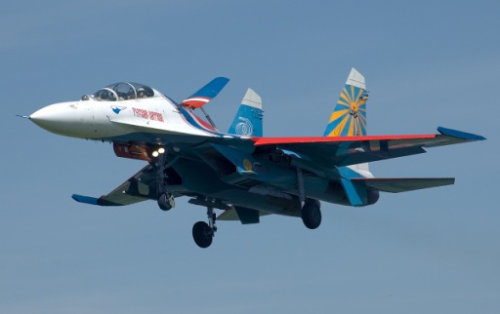
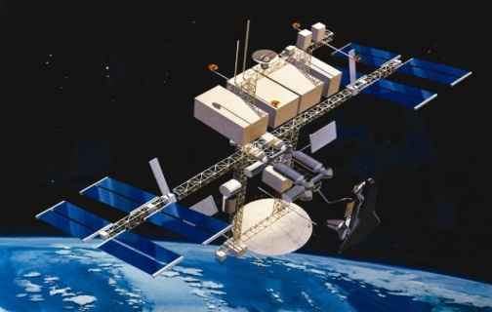
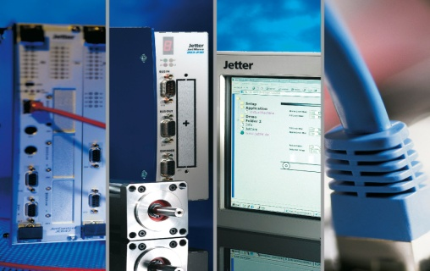

CPCI BASED ADVANCED LAUNCH COMPUTER
TECHNICAL OVERVIEW
Space
Telecom
Defense
Automation

Slide 2
HARDWARE OVERVIEW
S-484283C-2F-80 ----------------- CPCI Chassis
cBP-3206 --------------------------- 6 slots CPCI Backplane with Rear IO
cBP-3061 --------------------------- 3U CPCI Power Supply backplane
cPS-H325/AC ---------------------- CPCI Power Supply
cPCI-3510BLD/5700E/M16 ---- IntelR Core i7-5700EQ CPU
cPCI-R3P00 ------------------------- RTM
DGS25-01TD81BWAQC-J27 --- 1TB SSD
cPCI-XMCe Adapter --------------- XMC CARD
DSL – RKVM18-97TP ------------- 18.5” KMM

Slide 3
S-484283C-2F-80 SPECIFICATION

Slide 4
cBP-3206 SPECIFICATION
6-slot, 3U 32-bit CompactPCI backplane
Compliant to CompactPCI PICMG 2.0 R2.1 specifications
Right one slot is system slot & remain peripheral slots
10 layers PCB for accurate impedance control
Dimension: 141.3 x 128.7

Slide 5
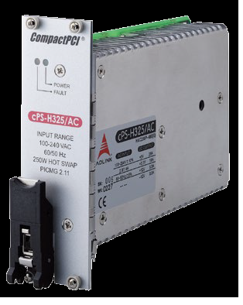
cPS-H325/AC SPECIFICATION
3U CompactPCI® 8HP form factor
250 W DC output
Hot swappable
Input Voltage: 90-264 ± 10% VAC
Input Frequency: 47-63 ±5% Hz
Input Current: 2.8 A @ 115 VAC
1.4 A @ 230 VAC
Output Voltage/Current
5V: Typ. 25.0A, Max. 33.0A
3.3V: Typ. 18.0A, Max. 33.0A
+12V: Typ. 5.0A, Max. 6A
-12V: Typ. 0.5A, Max.1.5A
Status LED:
Green: Valid I/P Voltage
Amber: Critical fault
Operating Temp: 40 °C to +70 °C
Storage Temp: -45˚C to +85˚C

Slide 6
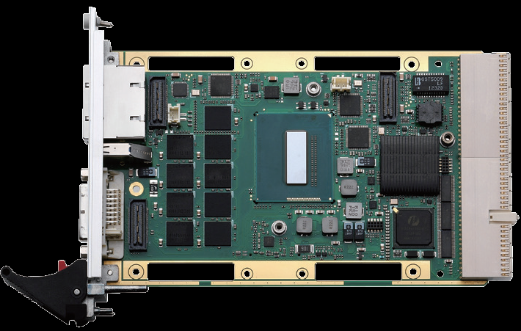
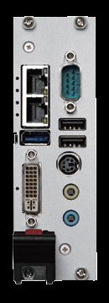
cPCI-3510BLD/5700E/M16 SPECIFICATION
Intel® Core™ i7-5700EQ Processor 2.6GHz, 3.4GHzTurbo
8GB DDR3L-1333 SDRAM ECC soldered
Mobile Intel® QM87 Chipset
DVI-I port on faceplate, VGA switchable to J2 (RTM) by BIOS setting
Reslution supports up to QXGA 2048x1536 pixels@75Hz, 32-bits
2x Gibabit Ethernet controllers
1x USB 3.0 port
2 x USB 2.0 port
CFast socket and SATA connector
PS/2 Keyboard/Mouse combo port
Line-in and Line-out port
1 x DB-9 RS-232/422/485
Operating Temperature: -20°C to +70°C
Storage Temperature: -50°C to +100°C

Slide 7
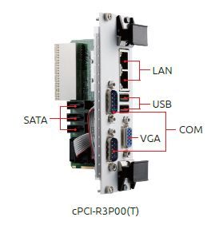
cPCI-R3P00 SPECIFICATION
8 HP Rear I/O module
1 x VGA port
2 x USB 2.0
2 x COM ports
3 x SATA ports
2 x Ethernet ports
Board Size: 100mm x 50mm

Slide 8
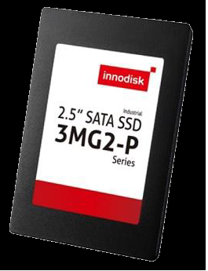
DGS25-01TD81BWAQC-J27 SPECIFICATION
2.5” SATA SSD
SATA III 6Gb/s
Flash Type: MLC
Max. Power Consumption: 6 W
Sequential R/W : 520 / 480 MB/s
Dimension (WxLxH): 69.85 X 100.0 X 6.9 mm
MTBF: 3 million hours
Storage Temperature: -55°C ~ +95°C
Operational Temperature: -40°C ~ +85°C

Slide 9
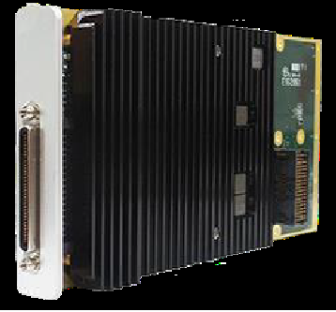
cPCI-XMCe SPECIFICATION
GPU: NVIDIA GeForce GTX 1050Ti
GPU: Clock 620 MHz
NVIDIA® CUDA™ Cores 768
Max. Digital Display Support: 3840x2160
Display Interface: 4* DVI or 4* HDMI via VHDCI
Floating Point Performance: 952.32 GFLOPS
Memory Size: 4GB GDDR5
Memory Clock: 7.0 Gbps
Memory Interface Width: 128 bit
Memory Bandwidth (GB/sec): 112
Max. Board Power Consumption (W): 30 W

Slide 10
DSL – RKVM18-97TP SPECIFICATION
DVI

Slide 26
ELECTRICAL OVERVIEW
Telecom
Defense
Automation

Slide 44
SIMULATOR INTERFACE TEST JIG
Space
Telecom
Defense
Automation

Slide 51
UMBILICAL INTERFACE TEST JIG
Space
Telecom
Automation

Slide 72
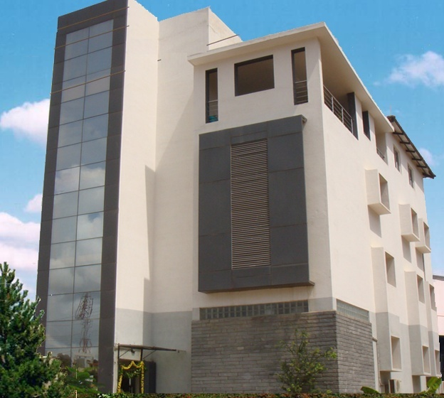

Contact Us …
Corporate Office :
Datasol Bangalore Private Limited
“Datasol House”, #793, Stilt & 1st Floor, Vyalikaval HBCS, (Behind BEL corporate office), 17th Cr. Road, Veeranna Palya, Nagawara, BANGALORE – 560 045
Ph: 080-2544 0642 /643 Fax: 080-2544 0644
E-Mail:
sales@datasolindia.com
support@datasolindia.com
Branches:
Hyderabad Trivandrum New Delhi
www.datasolindia.com

Slide 73



